Slide 1

GYM Management system

Slide 2

abstract
The Gym Management System is a database project developed using MySQL to efficiently manage the daily operations of a gym. The system stores and organizes important information such as member details, trainer information, membership plans, attendance records, and payment history in a centralized database. It helps reduce manual paperwork, improves data accuracy, and makes it easier to search, update, and retrieve records whenever required.

Slide 3
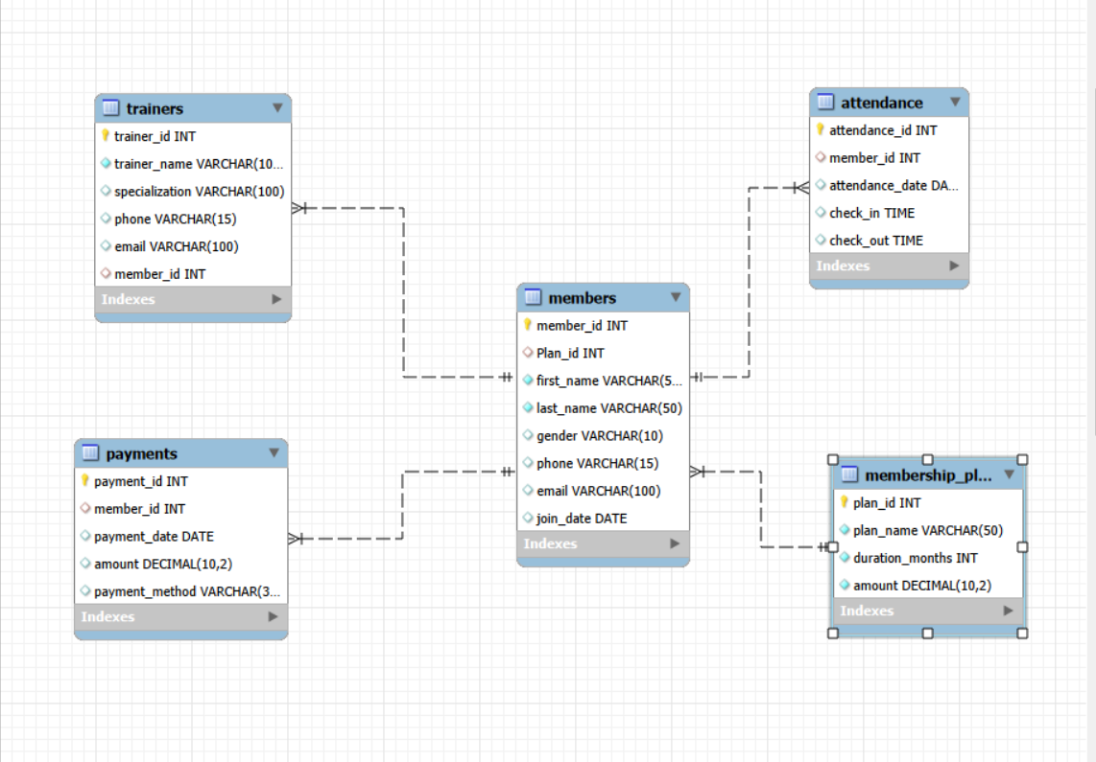
ER Diagram

Slide 4
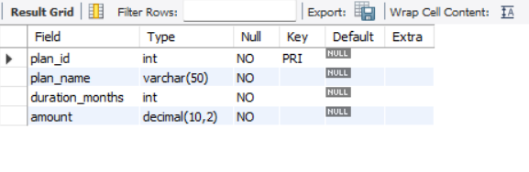
Structure of Table
Membership_plan Table
Membership_plan Table
This Table Stores All The Membership Plans Offered By The Gym, Including Their Name, Duration, And Fee. Each Plan Has A Unique Plan ID.
Syntax: Desc Membership_plan;

Slide 5
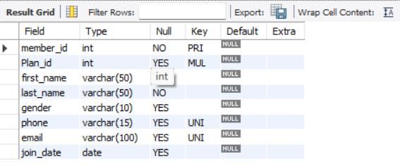
Members Table
Members Table
This Table Stores The Personal Details Of Gym Members, Such As Their Name, Gender, Phone Number, Email, And Joining Date. It Is Also Linked To The Membership_plan Table Through The Plan ID To Identify The Member's Selected Membership Plan.
Syntax: Desc Members;

Slide 6
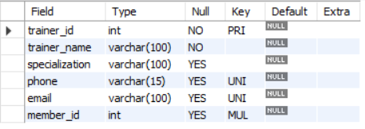
Trainers Table
Trainers Table
This Table Stores The Details Of Gym Trainers, Such As Their Name, Specialization, Phone Number, And Email. It Is Linked To The Members Table Through The Member ID To Show Which Trainer Is Assigned To A Particular Member.
Syntax: Desc Trainers;

Slide 7
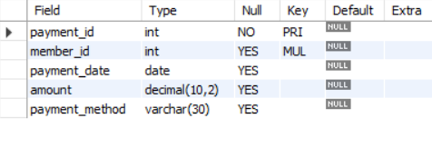
Payments Table
Payments Table
This Table Stores The Payment Details Of Gym Members, Including The Payment Date, Amount, And Payment Method. It Is Linked To The Members Table Through The Member ID To Maintain Each Member's Payment Records.
Syntax: Desc Payments;

Slide 8
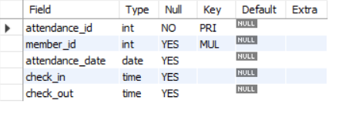
Attendance Table
Attendance Table
This Table Stores The Daily Attendance Records Of Gym Members, Including The Attendance Date, Check-in Time, And Check-out Time.
It Is Linked To The Members Table Through The Member ID To Track Each Member's Attendance History.
Syntax: Desc Attendance;

Slide 9
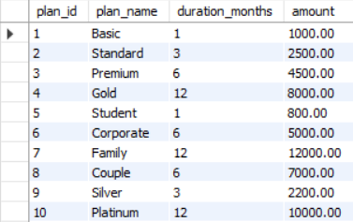
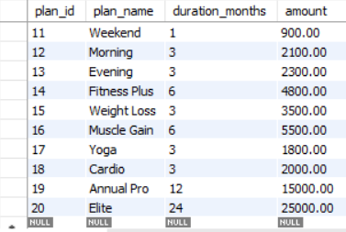
Contents Of Table
Membership_plan Table
Select * from membership_plan;

Slide 10
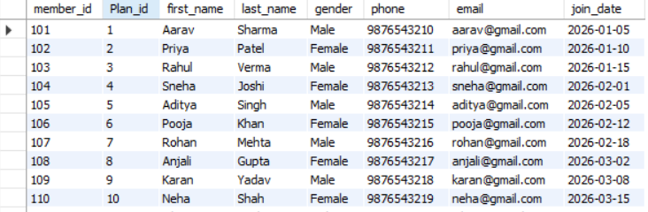
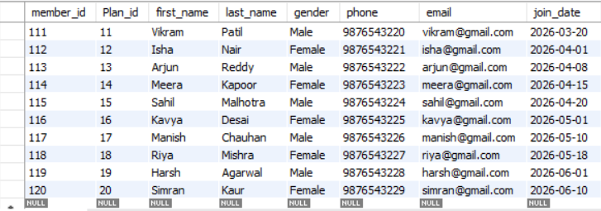
Members Table
Select * from members;

Slide 11
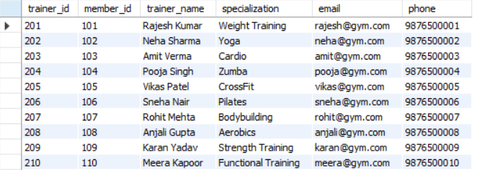
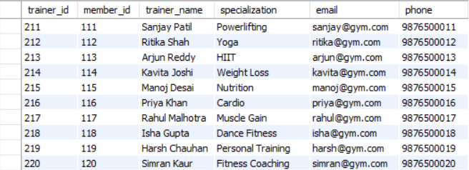
Trainers Table
Select * from trainers;

Slide 12
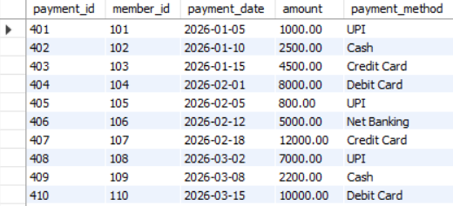
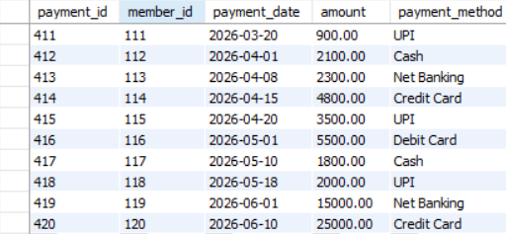
Payments Table
Select * from payments;

Slide 13
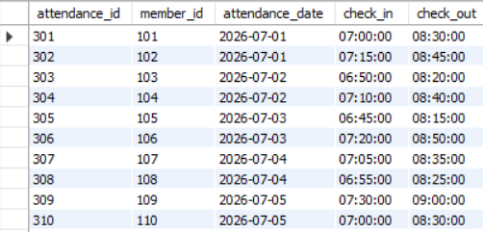
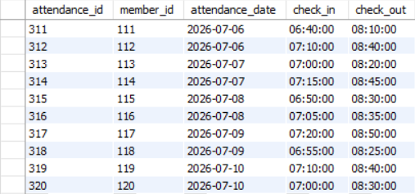
Attendance Table
Select * from attendance;

Slide 14

..
Sub queries

Slide 15

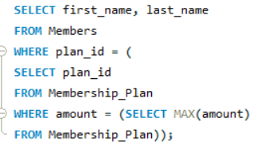
Display The Names Of MEMBERS Who Have Taken The Most Expensive Membership Plan ?
Syntax :
SELECT
m.first_name,
m.last_name,
mp.plan_name,
mp.amount
FROM Members m
JOIN Membership_Plan mp
ON m.plan_id = mp.plan_id
WHERE mp.amount = (
SELECT MAX(amount)
FROM Membership_Plan );

Slide 16
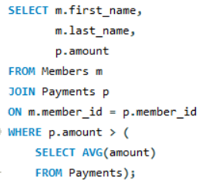
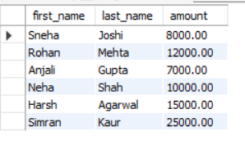
Display The Names Of Members Whose Payment Amount Is Greater Than The Average Payment Amount ?
Syntax :
SELECT
m.first_name,
m.last_name,
p.amount
FROM Members m
JOIN Payments p
ON m.member_id = p.member_id
WHERE p.amount > (
SELECT AVG(amount)
FROM Payments );

Slide 17
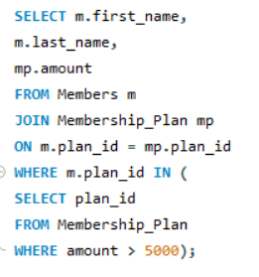
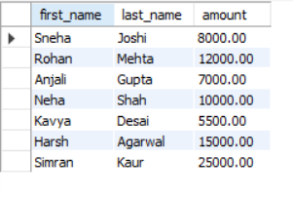
Display The Names Of Members Who Have A Membership Plan Costing More Than ₹5000 ?
Syntax :
SELECT
m.first_name,
m.last_name,
mp.amount
FROM Members mJOIN Membership_Plan mpON m.plan_id = mp.plan_id
WHERE m.plan_id IN
(SELECT plan_id FROM Membership_Plan WHERE amount > 5000);

Slide 18
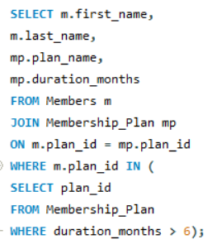
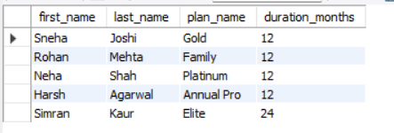
Display The Names Of Members Who Have Selected A Membership Plan With A Duration Of More Than 6 Months?
Syntax :
SELECT
m.first_name,
m.last_name,
mp.plan_name,
mp.duration_months
FROM Members m
JOIN Membership_Plan mp
ON m.plan_id = mp.plan_id
WHERE m.plan_id IN (
SELECT plan_id
FROM Membership_Plan
WHERE duration_months > 6);

Slide 19
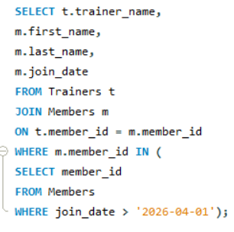
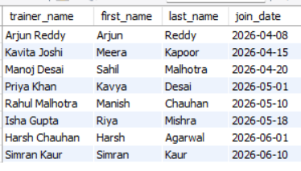
Display The Trainer Names Along With The Member Names And Join Date For Members Who Joined After 1 April 2026 ?
Syntax :
SELECT
t.trainer_name,
m.first_name,
m.last_name,
m.join_date
FROM Trainers t
JOIN Members m
ON t.member_id = m.member_id
WHERE m.member_id IN (
SELECT member_id
FROM Members
WHERE join_date > '2026-04-01’);

Slide 20

..
joins

Slide 21
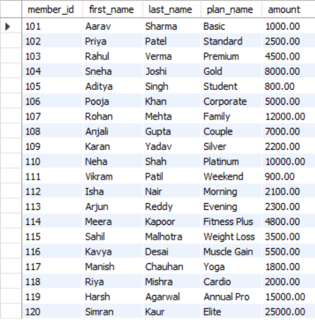
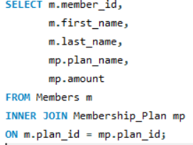
Display Each Member's Name Along With Their Membership Plan ?
Syntax:
SELECT
m.member_id,
m.first_name,
m.last_name,
mp.plan_name,
mp.amount
FROM members m
iNNER JOIN membership_plan mp
ON m.plan_id = mp.plan_id;

Slide 22
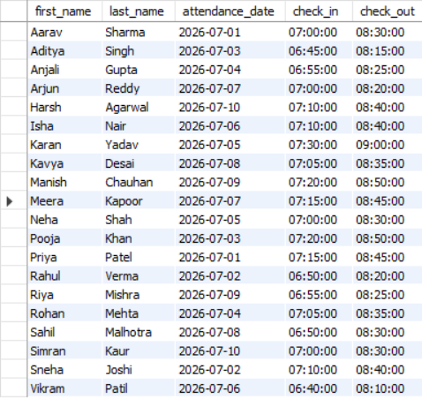
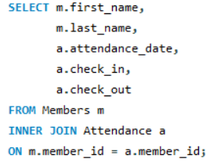
Display Each Member's Attendance Details?
Syntax :
SELECT
m.first_name,
m.last_name,
a.attendance_date,
a.check_in,
a.check_out
FROM Members m
INNER JOIN Attendance a
ON m.member_id = a.member_id;

Slide 23
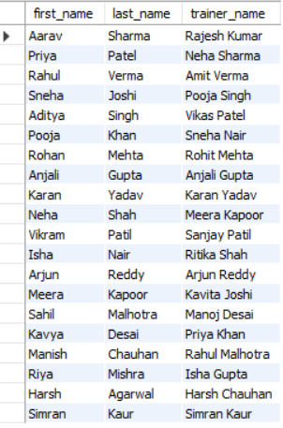
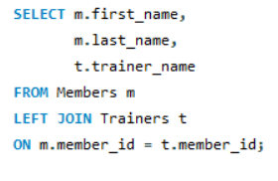
Display all members along with their trainers.
Syntax :
SELECT
m.first_name,
m.last_name,
t.trainer_name
FROM members m
LEFT JOIN trainers t
ON m.member_id = t.member_id;

Slide 24
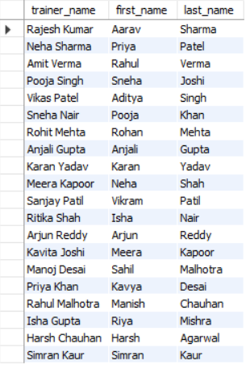
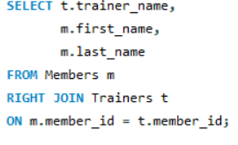
Display All Trainers Along With The Members Assigned To Them?
Syntax :
SELECT
t.trainer_name,
m.first_name,
m.last_name
FROM members m
RIGHT JOIN trainers t
ON m.member_id = t.member_id;

Slide 25
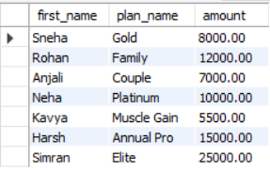
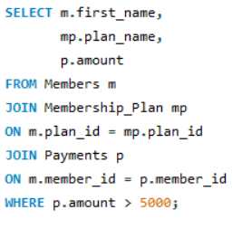
Display Members Who Have Paid More Than ₹5000 Along With Their Membership Plan?
Syntax :
SELECT
m.first_name,
mp.plan_name,
p.Amount
FROM Members m
JOIN Membership_Plan mp
ON m.plan_id = mp.plan_id
JOIN Payments p
ON m.member_id = p.member_id
WHERE p.amount > 5000;

Slide 26
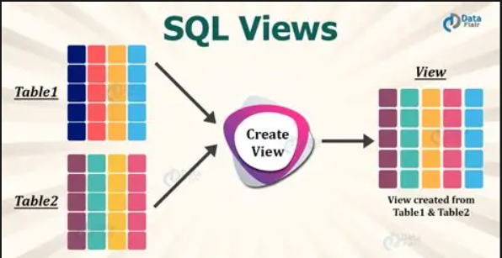
..
view

Slide 27
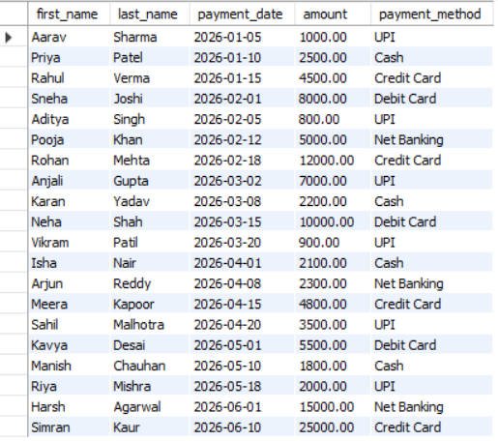
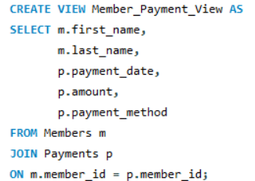
Display Member Names Along With Their Payment Details ?
Syntax :
CREATE VIEW Member_payment_view AS
Select
M.First_name,
M.Last_name,
P.Payment_date,
P.Amount,
P.Payment_method
FROM Members M
JOIN Payments P
ON M.Member_id = P.Member_id;
Select * From Member_payment_view;

Slide 28
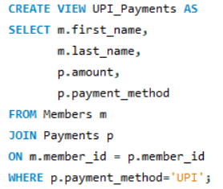
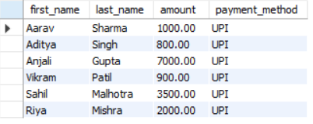

Display Members Who Made Payments Using UPI ?
Syntax :
CREATE VIEW Upi_payments AS
Select
M.First_name,
M.Last_name,
P.Amount,
P.Payment_method
FROM Members M
JOIN Payments P
ON M.Member_id = P.Member_id
WHERE P.Payment_method='upi’;
Select * From Upi_payments;

Slide 29
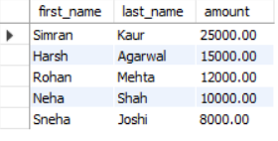
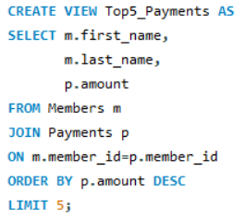
Display The Top 5 Highest-paying Members ?
Syntax :
CREATE VIEW Top5_payments AS
Select
M.First_name,
M.Last_name,
P.Amount
FROM Members M
JOIN Payments P
ON M.Member_id=p.Member_id
ORDER BY P.Amount DESC
Limit 5;
Select * From Top5_payments;

Slide 30

Prepared by :
JAMADAR SALWA ABDULKADER
IT VEDANT T380

Slide 31
Thank you

